Slide 1
BACCHUS WINERY
A CASE STUDY ON BUSINESS ACTIVITIES
BY THE CSD310 GREEN TEAM

Slide 2
GREEN TEAM MEMBERS
Joseph Youskievicz (The Brains)
Angela Tracy (The Brawn)
James Lilley (The Technician)
Micah Smith (The Meme Guy)

Slide 3
The case study
Stan and Davis Bacchus, the owners and operators of Bacchus winery, have commissioned the Green Team to perform an analysis of their business’ data. The aim was to produce reports based on the results of our analysis to guide Bacchus Winery in its next steps to improve operational efficiency. The winery needs to know several things about its data, such as:
The efficiency of supply procurement for winery supplier orders
Overall and specific sales strength of the products that the winery offers
The number of hours that the winery’s employees have worked during each quarter in the last fiscal year

Slide 4
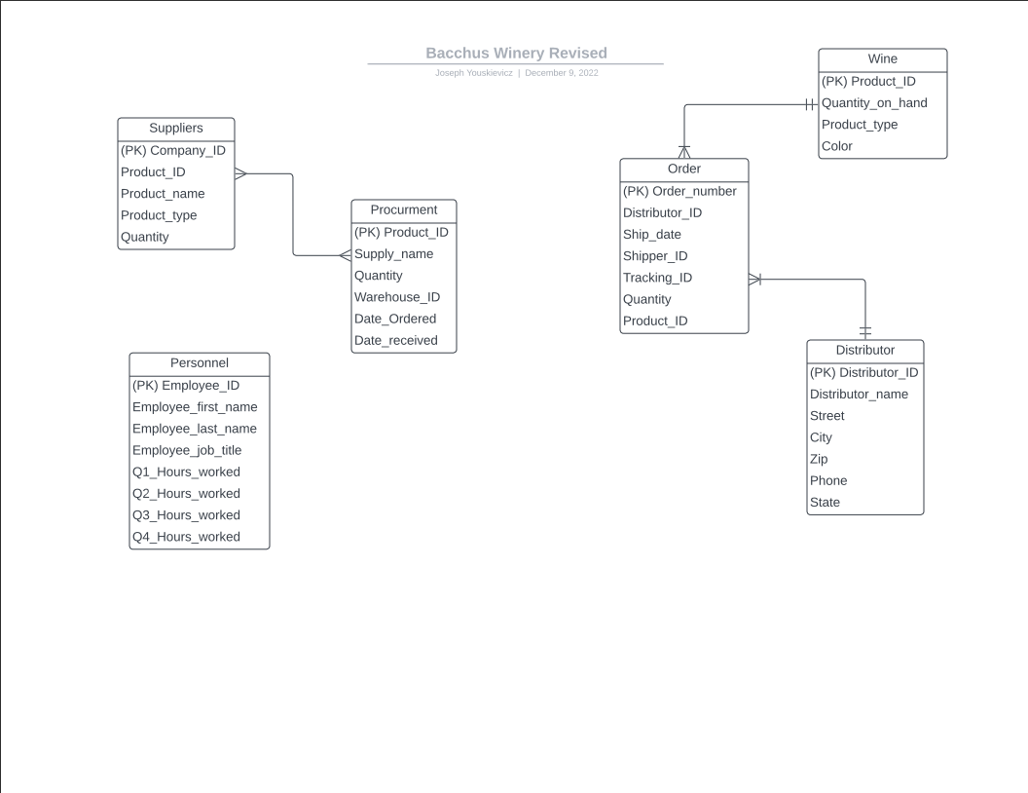
Entity relationship diagram

Slide 5
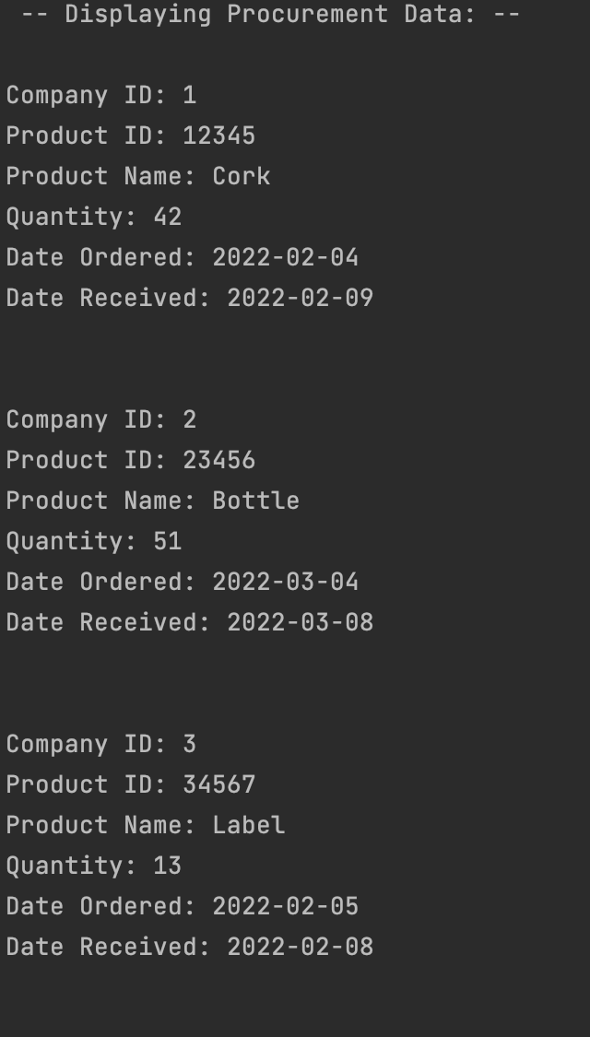
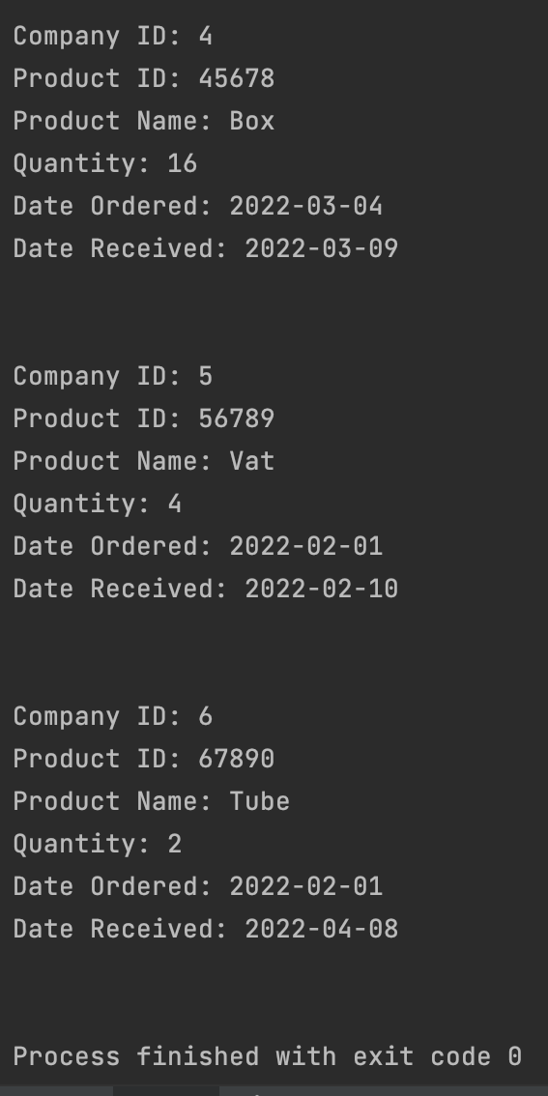
Report 1: supply procurement
The winery was interested in seeing how timely its suppliers were in fulfilling and shipping orders for the parts needed to execute day-to-day operations. The report for this analysis included the date of order placement; date of order receipt by the winery; and the names of the individual products ordered. Most of the orders placed were processed and shipped in a reasonable window of time, with one outlier for tubing:

Slide 6
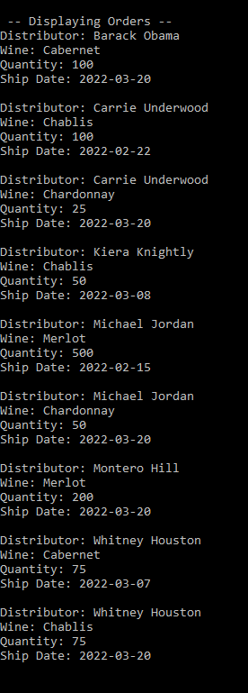
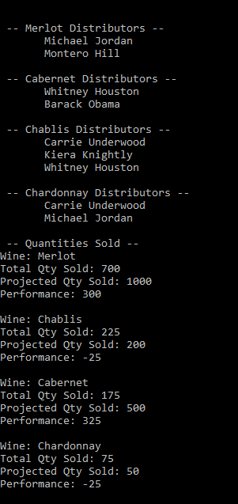
Report 2: sales
The winery also asked us to produce a report detailing its most important data: the strength of sales for its wine offerings. The sales were divided by distributor and included a ship date for each distributor’s orders. Sales at distributor locations were not evaluated as it is assumed by Bacchus and the Green Team that poorly performing wines would be ordered in fewer quantities by distributors.

Slide 7
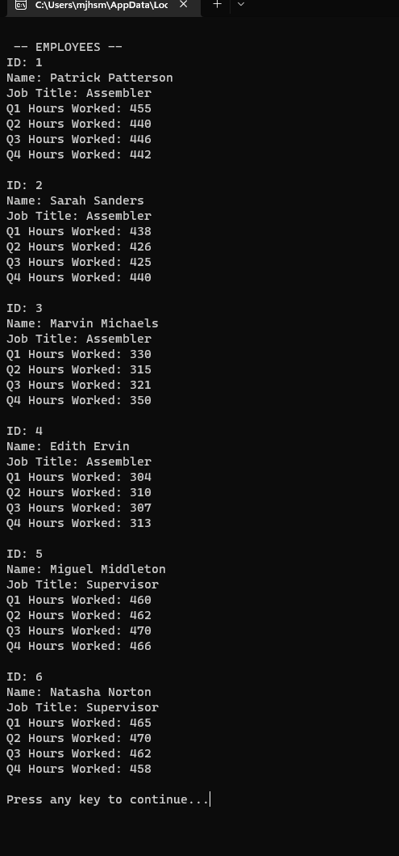
Report 3: employees
Finally, the winery asked us to provide an analysis of the number of hours that each of its employees worked during each quarter for the previous fiscal year. The report generated the total hours worked during each fiscal quarter (13 weeks). The function of the report was primarily to show whether the hours worked among employees was equitable, as this may show potential opportunities for attendance, performance, or overtime management.

